Slide 1









Data Management: H-E-B
Debleena Das, Han Yi Jiang, Noah Placke, Mounika Tarigopula, Sarah Teng, Katherine Wroble

Slide 2

TABLE OF CONTENTS
01
02
03
Our Company
Transactional Data
Data Warehouse
04
05
06
Data Lake
Data Governance
Reflections
The data management strategy
we recommend
How we would structure H-E-B’s transactional data model
How we would structure H-E-B’s data warehouse architecture
How we would structure H-E-B’s data lake architecture and analytics
How we would define H-E-B’s data governance mechanism
What we learned throughout this project and the semester

Slide 3







01
OUR COMPANY
The data management strategy we recommend

Slide 4



OUR COMPANY
H-E-B Grocery Company is an American privately-held supermarket chain based out of San Antonio, TX.
H-E-B operates more than 340 stores throughout the U.S. state of Texas, as well as in northeast Mexico.

Slide 5




DATA MANAGEMENT STRATEGY
Data Management Operating Model
Business Purpose
of Data
Characteristics of Data Under Management
Data Management Technology Architecture
Run the business and grow the business
Used for internal functions
Offensive data strategy
Provide customer insights for better service
Decentralized; H-E-B store data is kept separate from other stores
Store managers have governance over their own stores’ data and no others (unless they are higher up)
Internal customer, transaction, and product data collected through business functions
Always growing with each day/each new customer
Customer data is private
Structured data
Relational database
Privacy and other restrictions on customer data
Notes:
Mostly offensive - focused on customer service/experience and finding new ways to cater to the changing customer
Offensive because they’re constantly adapting to changes within environment/external factors
Competition is very high == need to be adaptive and offensive against competitors
Data privacy about customers, my heb app data == defensive strategy to protect this data
What is the data used for? What is their current data strategy?
Data needed for inventory, restocking, supply chain efficiencies, emergency response reserves, transportation logistics, etc.
marketing/advertising efforts - tv ads, newspapers, coupon books
Employee data and benefits

Slide 6




DATA STRATEGY
Mostly Offensive
Slightly Defensive
H-E-B should adopt a data strategy that is mostly offensive because they are a company built on customer service and quick response to emergency services.
H-E-B is constantly having to adapt to the changing customer and the changing environmental landscape. H-E-B also needs to be on the offensive side of things to stay competitive against other grocery store chains in Texas.
Although H-E-B is mostly focused on being offensive and catering to customer needs, they still need to be defensive in their data strategy to protect sensitive customer information both from internal store operations and mobile app operations as well.

Slide 7
02
TRANSACTIONAL DATA
How we would structure H-E-B’s
transactional data model
Notes:
Noah

Slide 8

Purpose of Transactional Database
Transactional Databases are meant to be denormalized.
Row-store database
Optimized for running production systems.
Read and write rows of data quickly.
Ensures Data Integrity

Slide 9







3 TRANSACTIONAL DATA SYSTEMS
Customers
Inventory
Transactions
Salesforce is a cloud-based Customer Relationship Management (CRM) software solution that provides customer management, marketing, and analytics tools.
Oracle Commerce is a cloud-based SaaS commerce solution that can help manage H-E-B inventory, supply chain, and logistics.
Dell EMC provides all-inclusive retail transformation solutions to handle point of sales and customer management. Catalina leverages customer data to provide personalized marketing solutions.

Slide 10
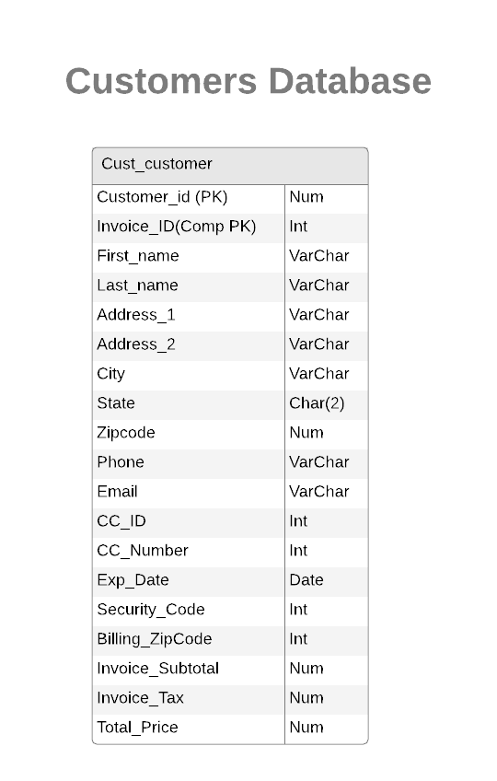



Customer Transactional Database ERD

Slide 11
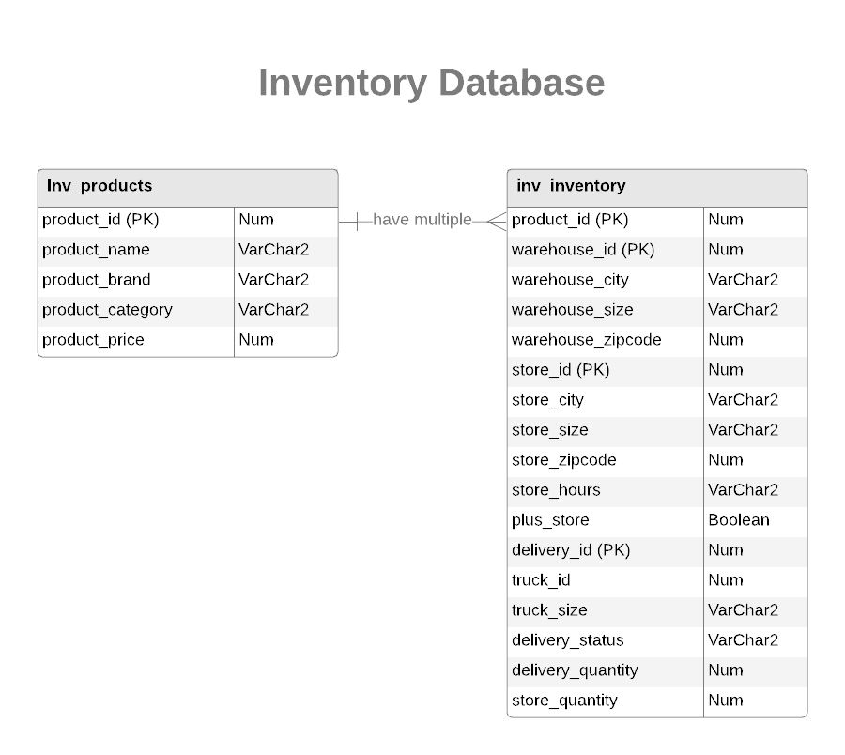




Inventory transactional Database ERD

Slide 12

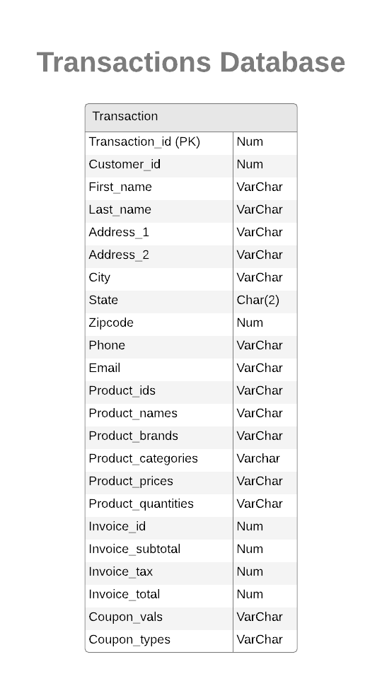
Transactions Transactional Database ERD

Slide 13
03
DATA WAREHOUSE
How we would structure H-E-B’s
data warehouse architecture
Notes:
Andy

Slide 14

Purpose of Data warehouse
Data warehouse is a central repository of data that can be used to analyze and make decisions.
Data warehouse takes data coming from transactional systems, and extract, transform and load into data warehouse database.
Data warehouse is usually built with third normal form.
Normalized database reduces data redundancy and ensure data get stored logically.
Ensure only related data is stored in each table.
With normalized data, it's much easier to analyze and make predictions.

Slide 15

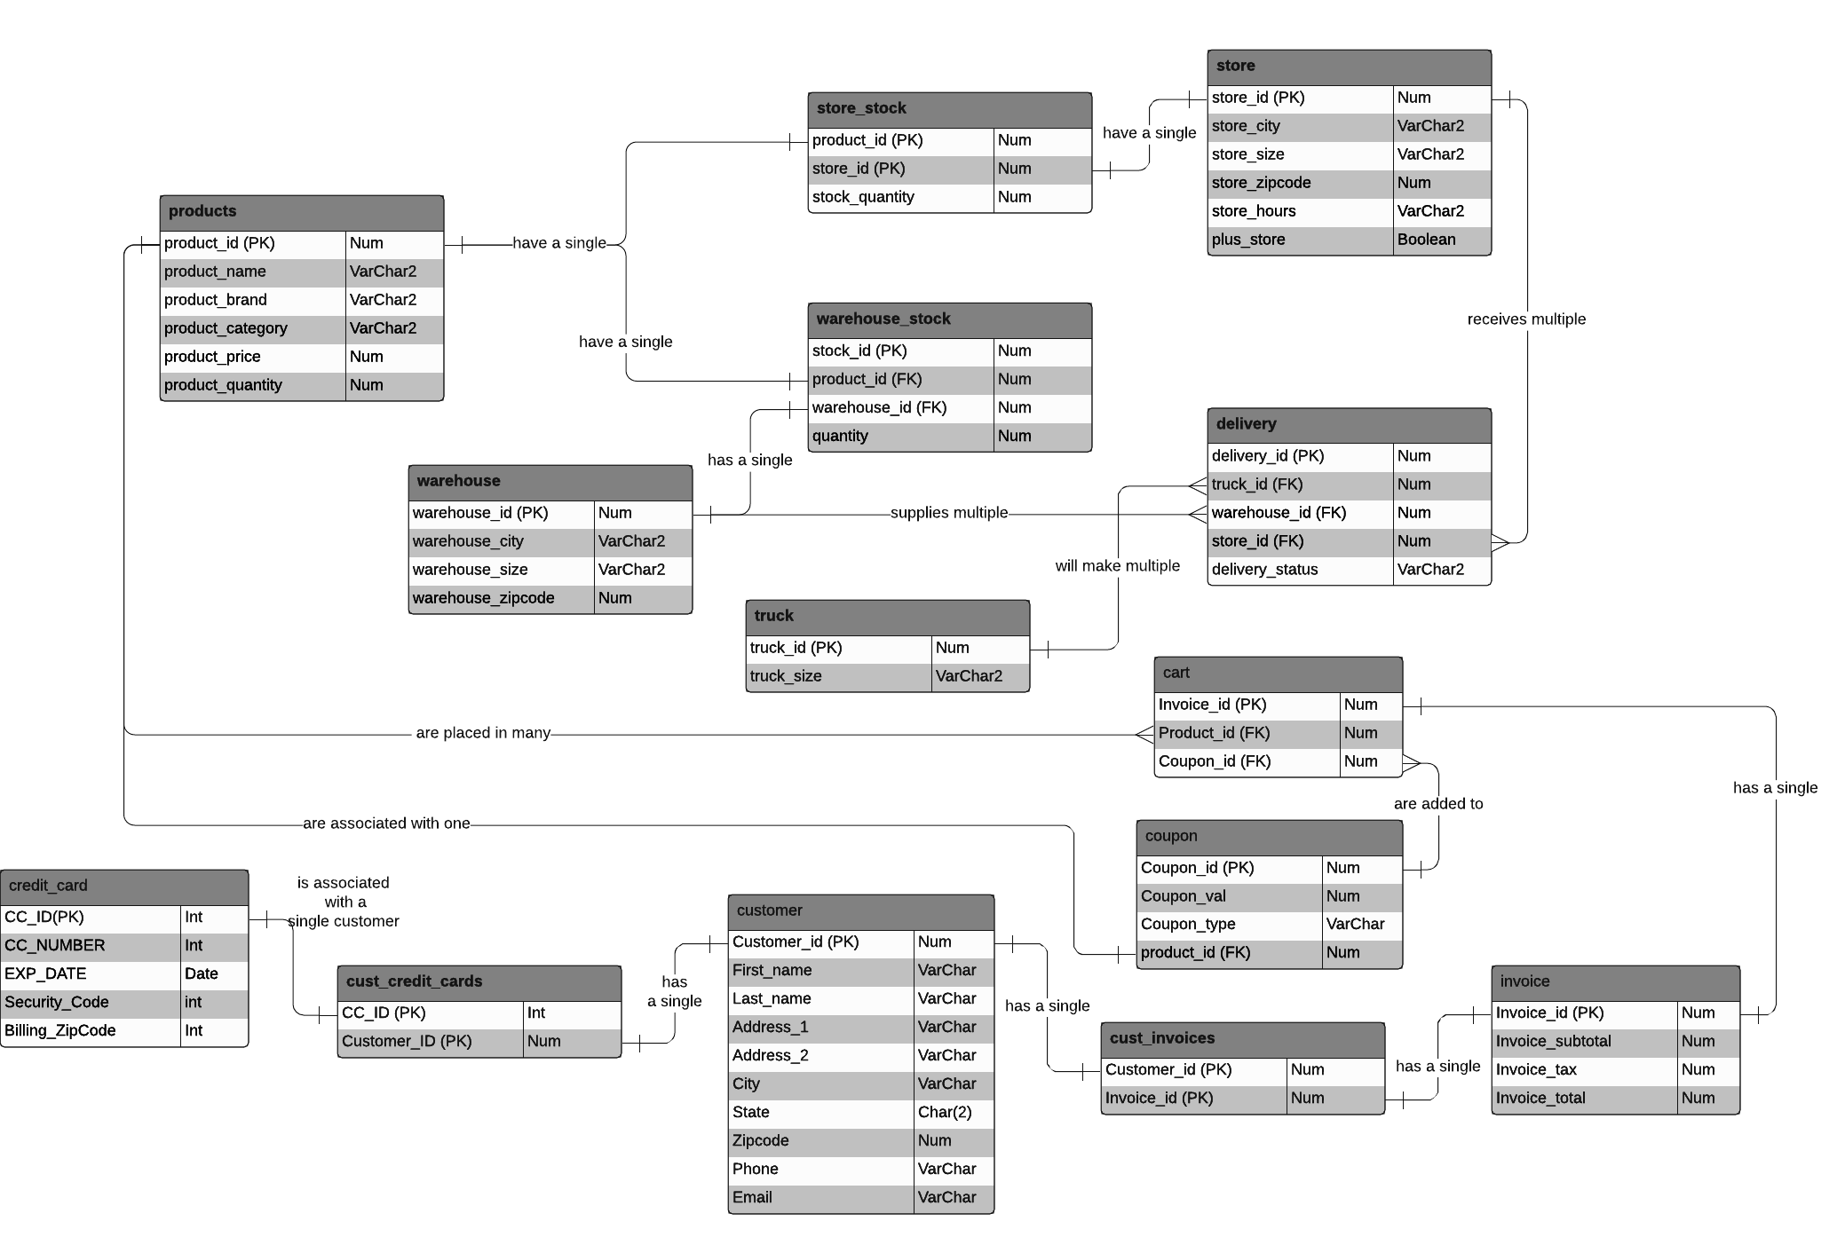
H-E-B Data Warehouse Architecture

Slide 16
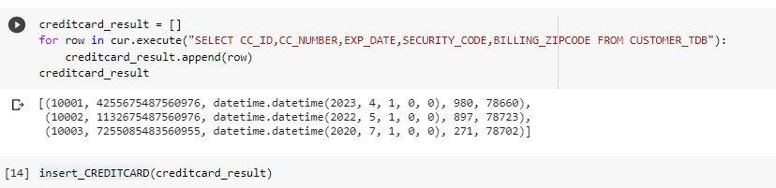
Extract, Transform, Load (ETL)
For data that doesn’t need much transformation, we can simply select the columns we want from the transactional database to insert into the data warehouse database.
Notes:
Andy

Slide 17
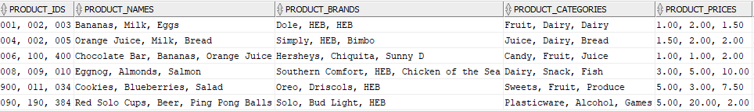
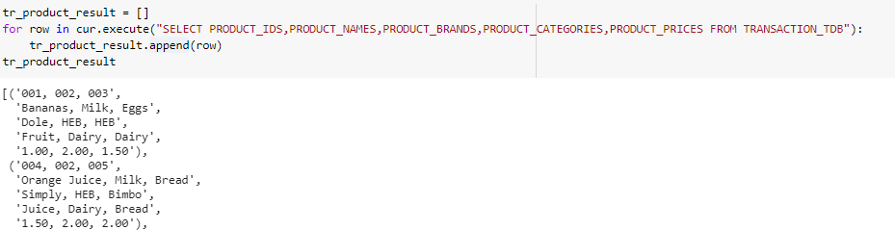
Extract, Transform, Load (ETL)
For data that requires transformation, we will have to use python to transform it.
As you can see from the data below, there are multiple product ID under one row of product_IDs.

Slide 18
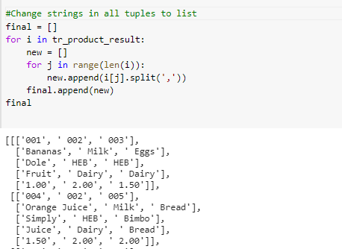


Extract, Transform, Load (ETL)
In-order to iterate through the product_id and connect them with their matching product name, brand and price, we have to split the string into lists.

Slide 19

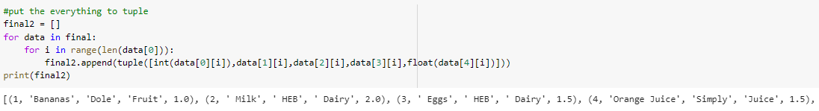
Extract, Transform, Load (ETL)
Now, the next step it to pack the product_ID with its corresponding name,brand and price into list of tuples.

Slide 20
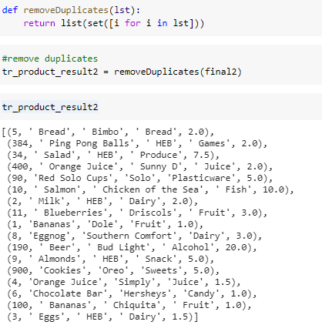
Extract, Transform, Load (ETL)
Last but not least, we remove duplicates in the list of tuples, so when I insert to the database, there will be no violation on constraints.

Slide 21
04
DATA LAKE
How we would structure H-E-B’s
data lake architecture and analytics
Notes:
Mounika

Slide 22


H-E-B Data Lake Architecture
Data Lake is a storage repository that can store large amount of structured, semi-structured, and unstructured data
Data lakes are particularly valuable in analytical scenarios
In our scenario, we have constructed the data lake to analyze customers & transactions.
In the same way, we can do any combinations like:
Products - Customers
Inventory - Delivery - stores
Products - Inventory
Products - Transactions
For purposes of this project, we have created a View in SQL developer to serve as our ‘Data Lake’ and will perform analytics on that view

Slide 23
Star Schema Data Lake
Data Mart
(customers & transactions)
Data
ETL
Enterprise Data Warehouse
Data Mart
(customers & products)
Data
Data Mart
(products & inventory)
Data
Data Mart
(products & transactions)

Slide 24
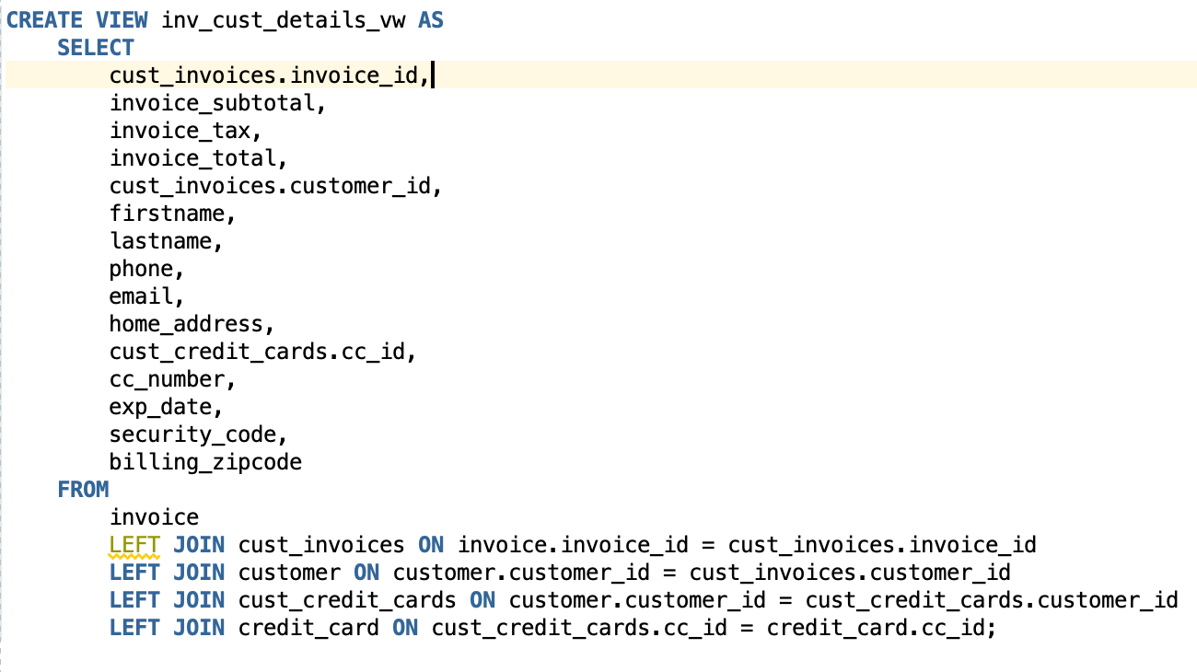
View as Data Lake

Slide 25

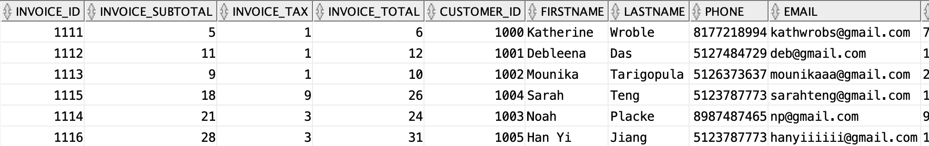
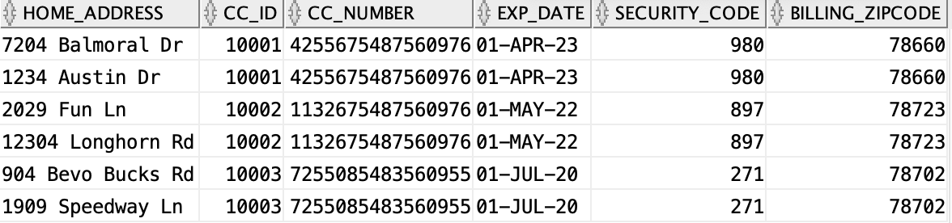
Result of Data Lake

Slide 26
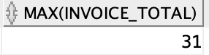
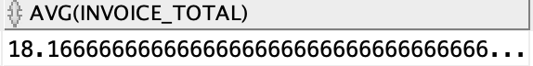
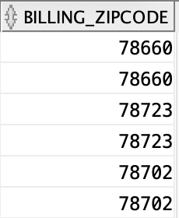
Data Analytics
What is the max invoice total for customers at H-E-B?
What is the average invoice total for customers at H-E-B?
What regions (or zipcodes) are H-E-B customers from?

Slide 27
05
DATA GOVERNANCE
How we would define H-E-B’s
data governance mechanism
Notes:
Debleena

Slide 28
H-E-B Data Data Governance Structure
H-E-B’s data governance structure will involve a specified branch (or team) within H-E-B’s internal operating system who will handle the bulk of controlling, securing, and managing all of H-E-B’s data
We will call this branch H-E-B Digital
For H-E-B, our data governance mechanisms will focus on inventory and customer transactions in order to ensure proper product stock levels
This allows for each store to maintain supply and demand based off measurements of performance
Implement data policies for consistency/easy transfer of data to all departments in HEB’s infrastructure to make business decisions
Notes:
Debleena
For your selected company describe the data governance mechanism that you will implement? Explain your rationale.
Develop, publish and manage enterprise wide data definitions and semantics
•
Identify, address, resolve and monitor data related issues
•
Measure, monitor and communicate data quality parameters and issues
•
Publish and promote policies, procedures and rules, including those related to
privacy, regulatory and contractual compliance
•
Foster a culture and values that promote high quality data related practices and
create zero tolerance for errors in mission-critical data
•
Coordinate and facilitate the integration of data-driven business needs and
priorities with IT requirements and constraints
•
Provide business friendly Data Governance communication

Slide 29
06
REFLECTIONS
What we learned throughout
this project and the semester
Notes:
Katherine

Slide 30
REFLECTIONS
What did you learn?
What was most valuable?
What are additional opportunities for learning that this project did not capture? How can we change this project to capture these opportunities?
How can you use this learning going forward?
We learned how to think about a data management strategy wholistically, create fast transactional models, then transform them into a fully integrated data warehouse.
Learning how to extract the data, transform it from denormalized to 3nf, and load the data into the data lake is a valuable skill we can use in our future careers.
We can use what we learned in this project in our careers when designing data management strategies and creating data governance structures. We also know that this project will be extremely useful when in interviews.
We enjoyed working more with relational databases, but would have liked to get more experience with NoSQL databases as well. Given more time for this project, it would have been fun to create both a relational and NoSQL database for our chosen company.
Notes:
Katherine
What did you learn?
What was most valuable?
How can you use this learning going forward?
What are additional opportunities for learning that this project did not capture? How can we change this project to capture these opportunities?

Slide 31
THANKS!
Questions?

